Slide 1
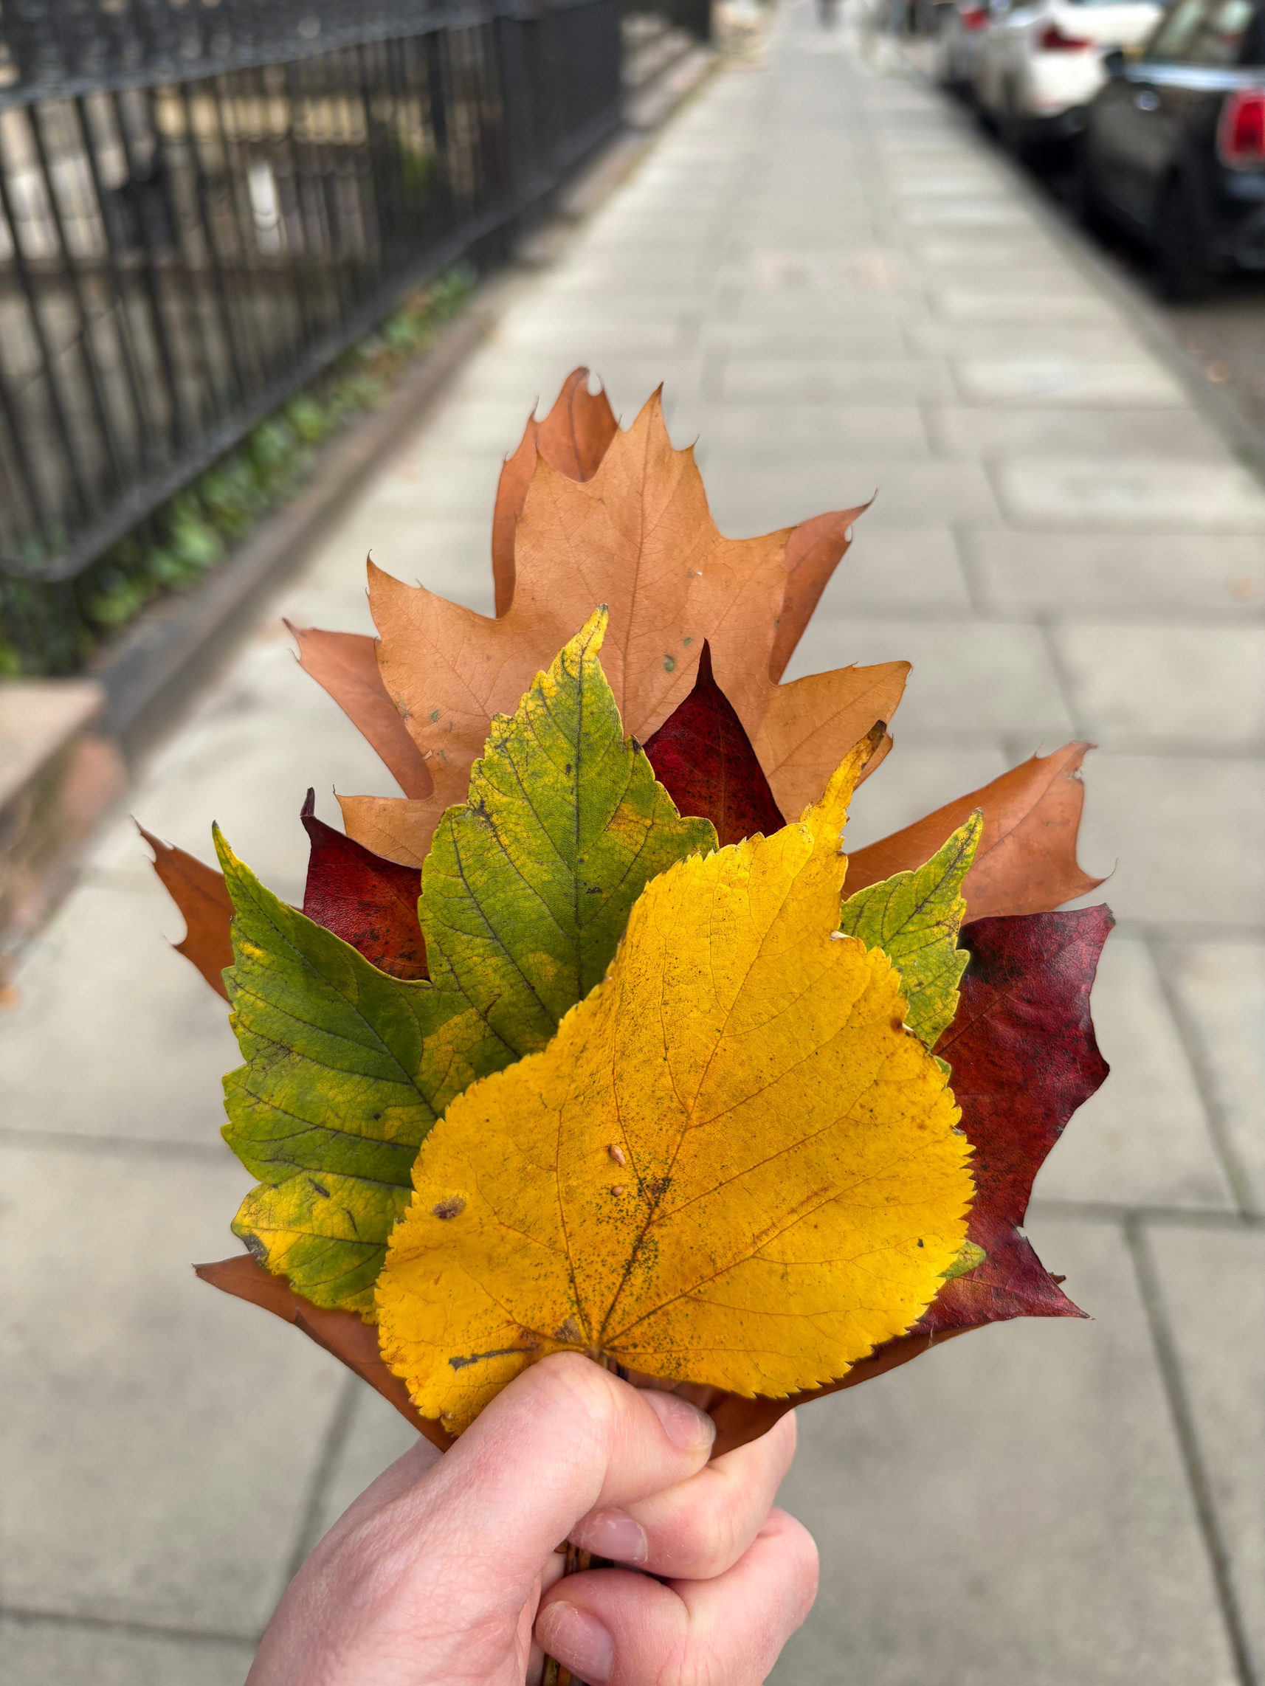
Celebrating Autumn/ Winter 2025/26 so far…

Slide 2
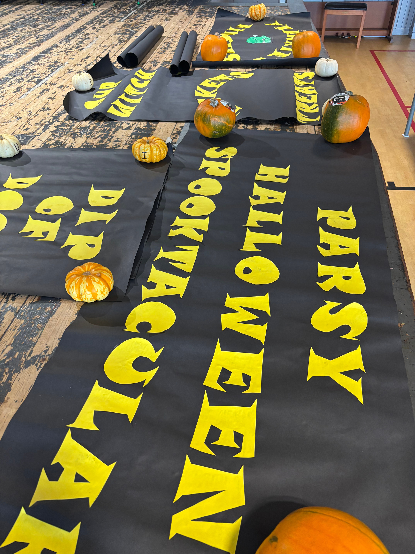

🧡 Favourite Moments in the School Year
You Said: Families love seasonal highlights like Halloween, the Nativity, Crazy Hair Day, and community events like the Summer Fayre and Talent Show.
We Did:
Delivered a hugely successful Halloween Spooktacular, praised for its inclusive atmosphere and joyful participation. Raising £850
Launched the Community Scarecrow Trail with 32 entries and strong engagement through trail booklets. Raising £340
Held the annual costume swap to make the Halloween disco accessible and sustainable.
Held our first garden tidy of the year, giving children a chance to take pride in their school environment.
Celebrated Crazy Hair Day, bringing laughter and a sense of shared fun across the school. Raising £420

Slide 3
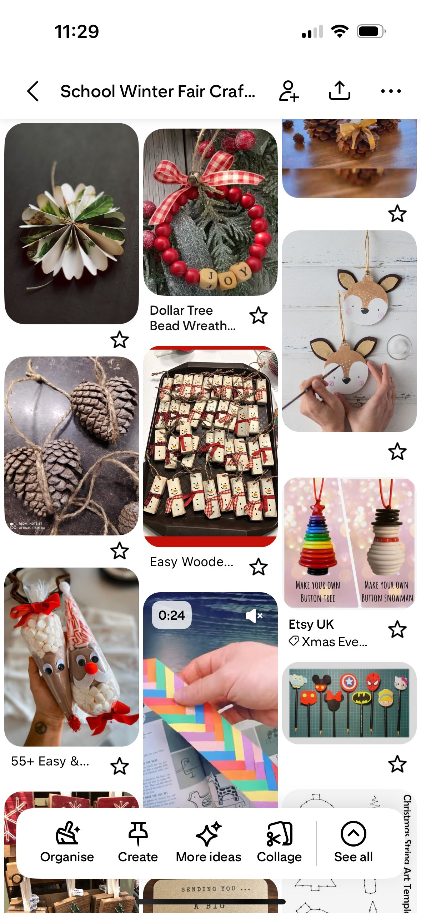
✨ Wishes to ‘Magic’ into School Life
You Said: You’d love to see more creativity, outdoor learning, cultural celebration, and emotional support.
We Did:
Created craft business opportunities for every class at the Winter Fair, blending maths, creativity, and enterprise.
P7 pupils are designing games and crafts for the Winter Fair, with Santa and Mrs Claus joining the festivities.
Started Wildside Nature Club to nurture outdoor learning and connection with nature.
Hosted Eco Coffee Morning to celebrate sustainability and community action.
Continued the neurodiversity and ASN meet-ups, offering gentle, supportive spaces for families to connect. Created an information resource for parents on neurodiversity.

Slide 4
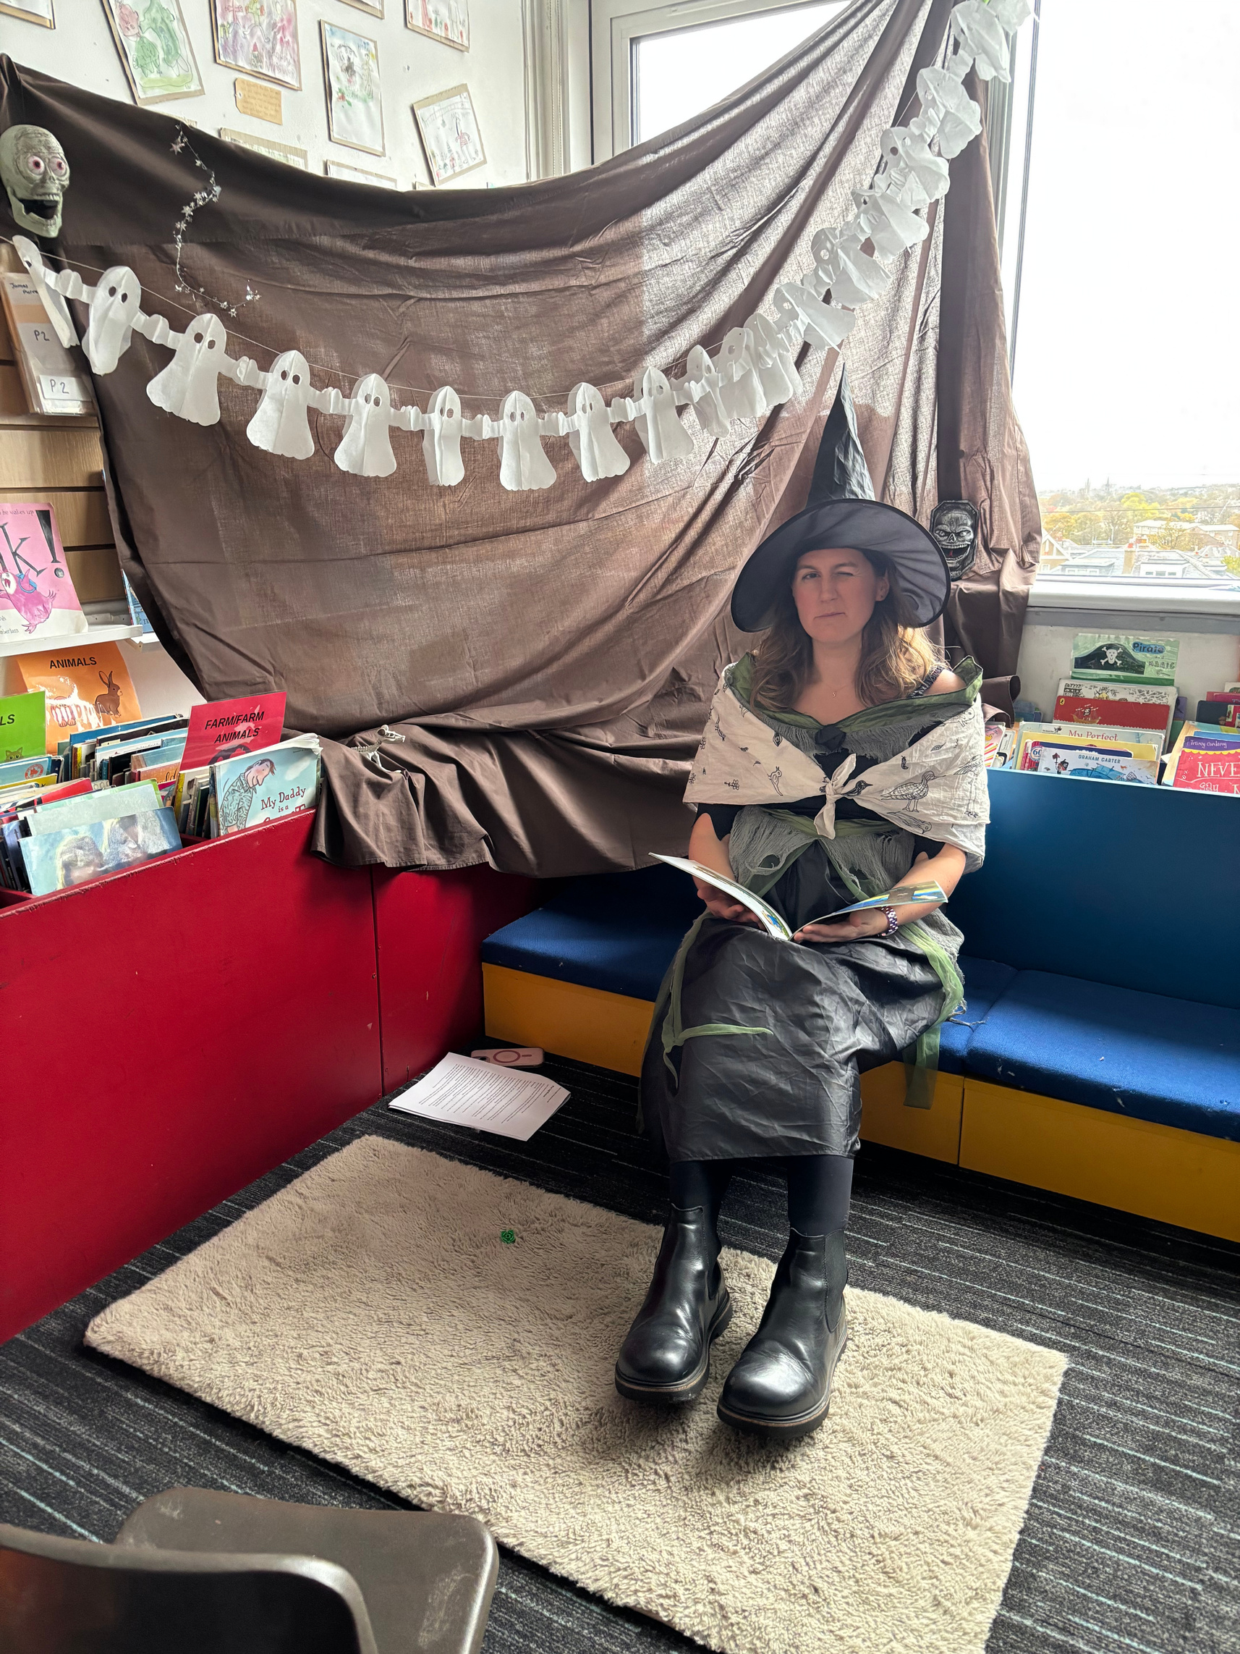
🛠 Parent Superpowers & Offers of Help
You Said: You’re ready to help with reading, gardening, events, fundraising, and more.
We Did:
Welcomed 20 completed PVGs, expanding our pool of volunteers.
Supported the football team with new kit, thanks to parent-led fundraising and coordination.
Continued to support the welfare fund, helping families access essentials and opportunities.
Continued the library volunteer programme, helping to enrich reading culture and support literacy.
Introduced new school fundraising opportunities

Slide 5
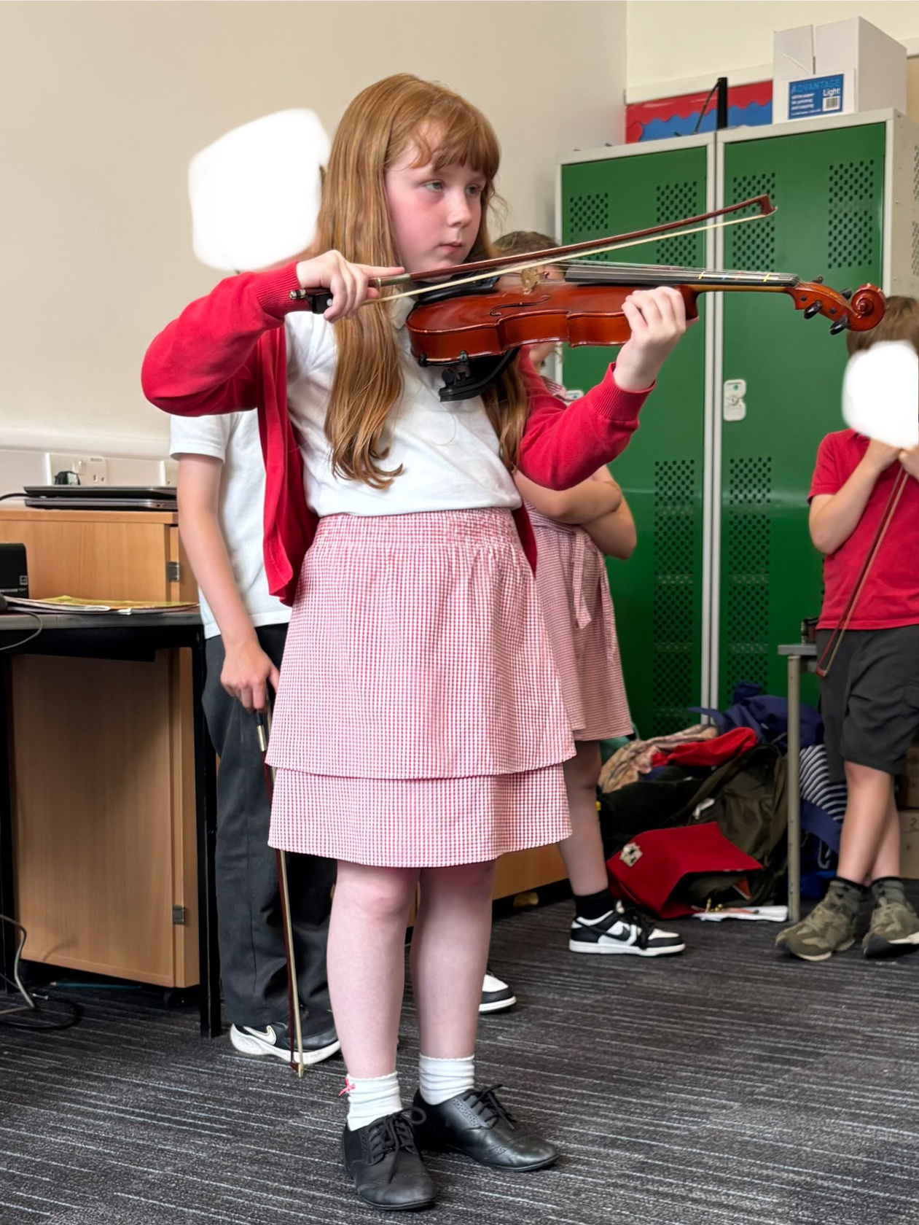
🎭 Events & Activities Suggestions
You Said: You’d love more music, theatre, and creative opportunities.
We Did:
Restarted the choir/singing club, now preparing to sing carols at a local nursing home and the Winter Fair
Restarted violin lessons, now preparing for the Christmas concert
Started a Judo Club, adding variety to extracurriculars.
Supported craft-based enterprise projects at the Winter Fair, giving every child a chance to shine.

Slide 6
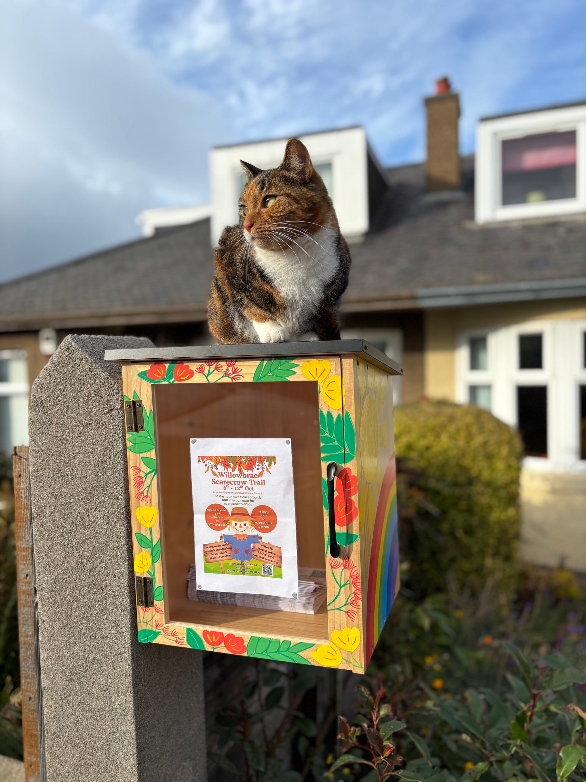
📣 Communication & Inclusion
You Said: You want clearer, more personal communication and better reach to all families.
We Did:
Moved to a WhatsApp Community for streamlined class updates, sub-groups, and event announcements.
Updated the school website with improved communications and updated the live school calendar.
Scheduled the first Parent Council AGM alongside a school event, boosting attendance and accessibility.
We plan to:
Launch our communications survey to hear more about what works for you.

Slide 7
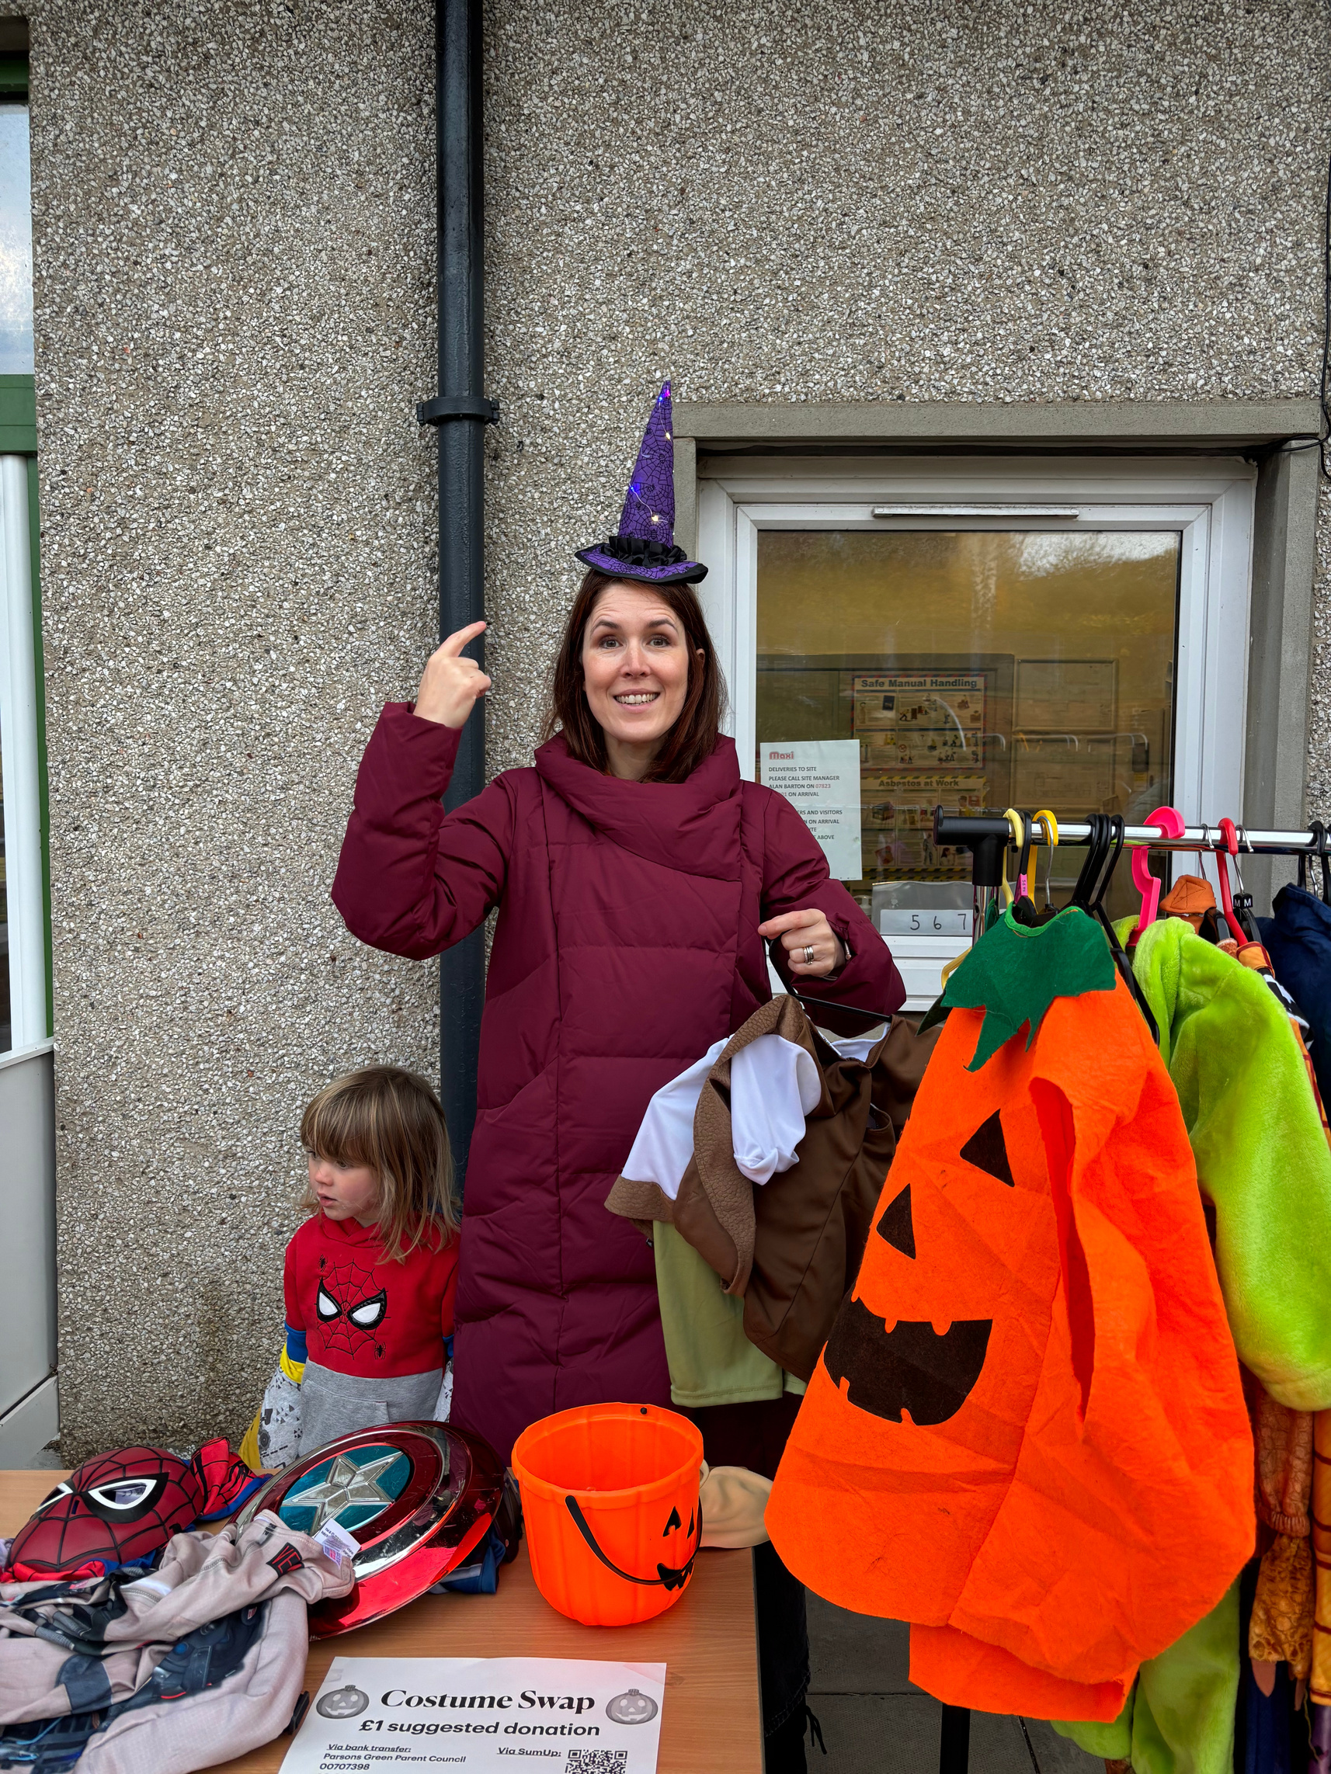
🧩 Practical Enhancements
You Said: You’d like to see more support for logistics, wellbeing, and everyday school life.
We Did:
Offered a costume swap to reduce pressure and increase inclusion.
Held our first garden tidy, encouraging responsibility and pride in the school grounds.
Continued support for the welfare fund, ensuring no child misses out due to financial barriers.

Slide 8

🌈 Neurodiversity & Emotional Support
You Said: You want more understanding and support for neurodivergent children and families.
We Did:
Restarted monthly neurodivergent and Additional Support Needs meet-ups, creating safe spaces for connection and shared experience.
Created an information resource for parents on neurodivergent resources
Explored sensory-friendly ideas and inclusive practices across events and communications. Halloween Spooktacular – brighter, quieter disco with activities for children to participate in, created more alternative options with storytelling, craft and cinema so everyone could feel more involved. Worked with parents to share what had been planned so they could prepare their young people on what was involved.

Slide 9
💸 Fundraising & Donations
You Said: You’d like flexible ways to support the school, even if you can’t volunteer.
Look into how we can do this further over the Spring Term.
We plan to:

Slide 10
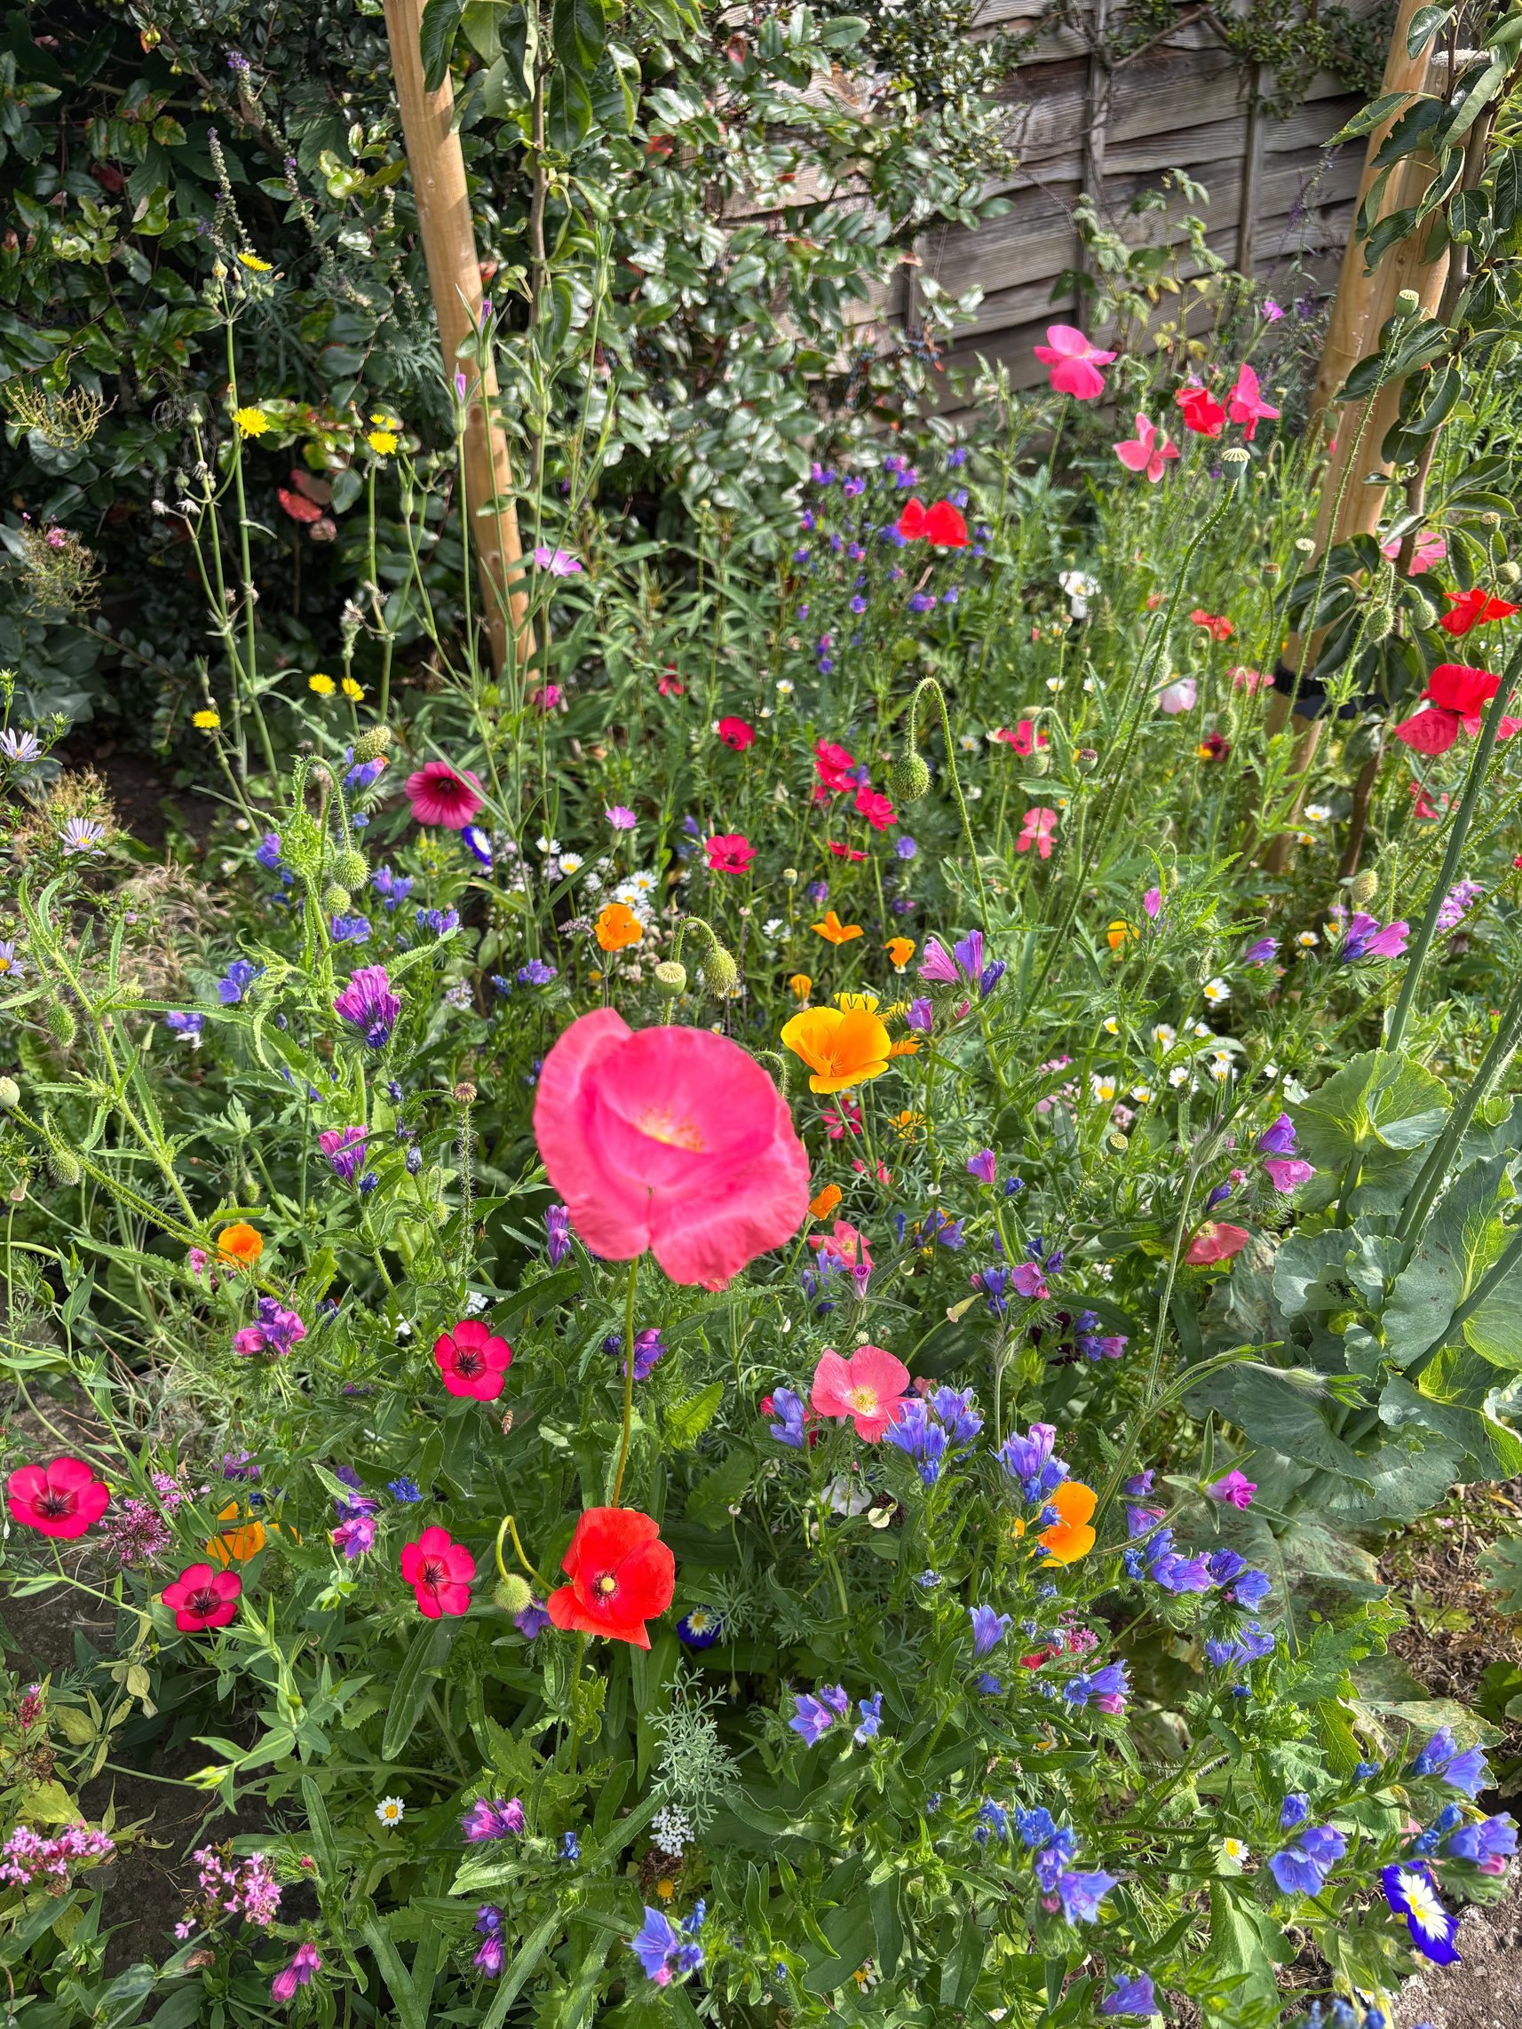

🍽 Food & Facilities
You Said: You’re curious about what kids want for dinners and want to see respect for school property.
We Did:
Encouraged ownership and pride through activities like the garden tidy and craft enterprise.
We plan to:
Continue conversations around school dinners and property respect and develop ideas with parent and family feedback.

