Slide 1
Overview of Parent Council Accounts:
Key Financial Highlights 13/8/25 – 6/11/25
Dan Darwin-Clements (PGPC Treasurer)

Slide 2

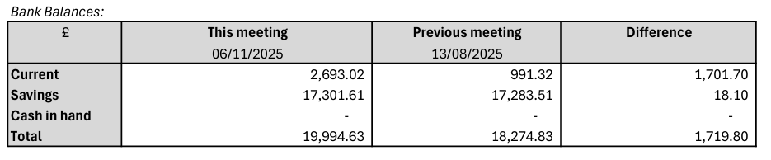
CAsh
  The cash held at bank has increased by ~ £1700 over the period.
  This doesn’t necessarily represent the net income over the period due to a number of outstanding (approved) expenses and invoices which will have yet to be paid.

Slide 3
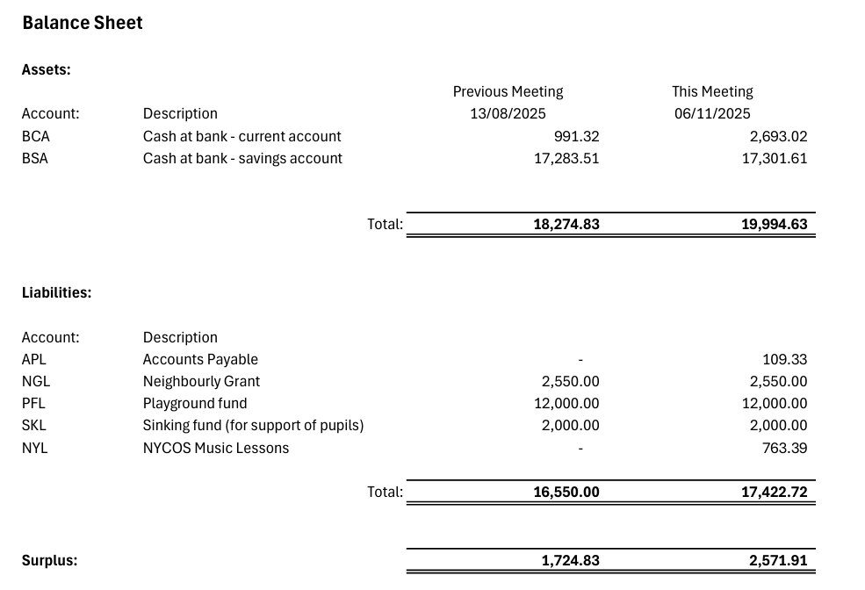
Balance SHEET
Income Sources
  Significant designated funds continue to shape the profile of available reserves (e.g. Playground Fund).
Notes:
---

Slide 4
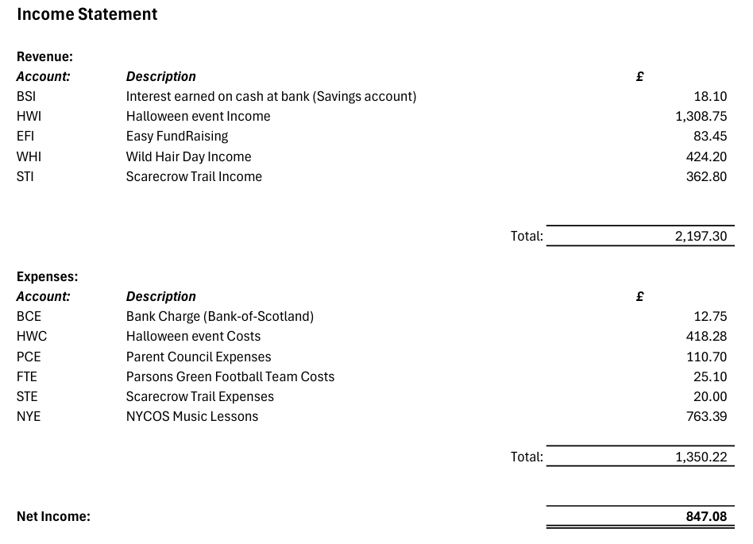
Summary of Income and Expenditure
(13/8 – 6/11)
Income Sources
  Most revenue is received from fundraising events in particular the Halloween Disco.
  Expenditure Details
  Expenses are incurred in running events as shown. Funds are spent on various school projects and activities supporting student learning and development (such as the NYCOS music lessons).
Notes:
---

Slide 5
Conclusion
Financial Stewardship
If you have any questions on how the summary accounts are prepared or any of the process involved, please don’t hesitate to get in touch!
Talk to Me!
If you are organizing or running an event within the school and require support to produce QR codes (for SumUp), manage payments etc.
Notes:
Total cash rose by £1,719.80 to £19,994.63 since the previous valuation point (current account up to £2,693.02; savings broadly flat with £18.10 of interest) . Over the period, revenue of £2,197.30 was driven largely by community events—Halloween (£1,308.75), Wild Hair Day (£424.20), and the Scarecrow Trail (£362.80)—supplemented by Easy FundRaising (£83.45) and bank interest (£18.10); expenses totalled £1,350.22, led by NYCOS Music Lessons (£763.39) and Halloween costs (£418.28), producing a net surplus of £847.08 . On the balance sheet, liabilities increased to £17,422.72 (from £16,550.00) with new items for Accounts Payable (£109.33) and NYCOS Music Lessons (£763.39), while ring‑fenced funds remain substantial: Playground fund (£12,000), Neighbourly Grant (£2,550), and Sinking fund (£2,000) . Consequently, free reserves (surplus) improved from £1,724.83 to £2,571.91. Overall, the period features strong event‑led fundraising, modest bank interest, and spending focused on music lessons and event delivery, with significant designated funds continuing to shape the profile of available reserves .

